Slide 1
FINAL PROJECT
Text based adventure game < COLLAPSE >
By : Muhammad Lukman Ismail Hanafi

Slide 2
WHAT IS COLLAPSE ?

Slide 3
Problem
Inventory
Sort Inventory
Maze

Slide 4
Inventory
Linked List
Queue
Stack
Vector
Array

Slide 5
Sort Inventory

Slide 6
Maze
BFS – Breadth first search

Slide 7
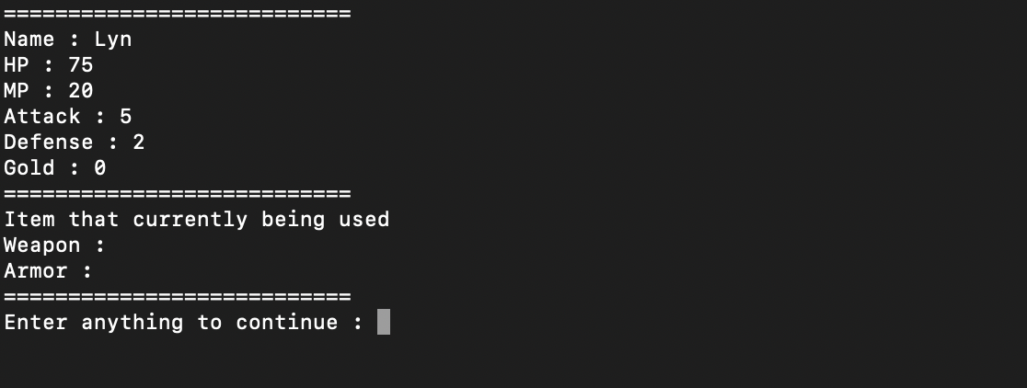
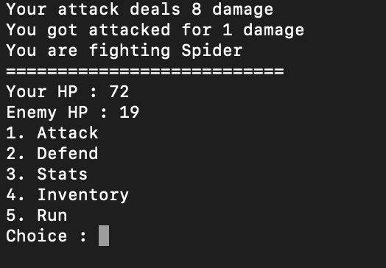
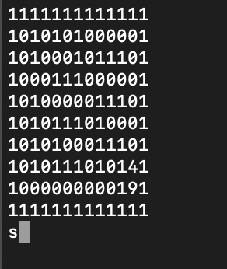
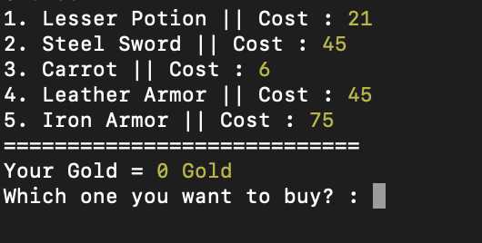
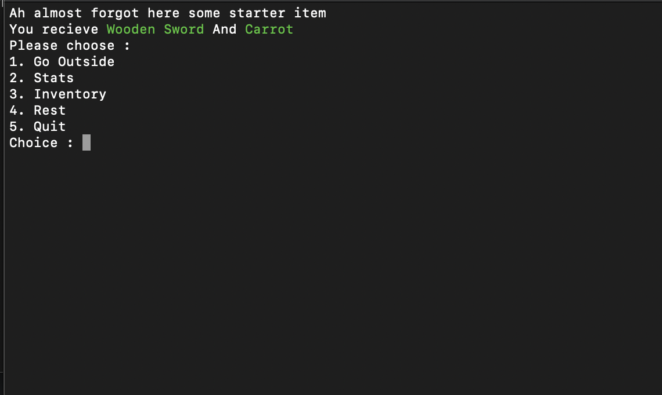
RESULT

Slide 8
DEMONSTRATION

Slide 9
THANK YOU.

